Slide 1
Wireless IOT 2IOT
LoRa Lab ESP

Slide 2
Part 1
Read sensor locally

Slide 3
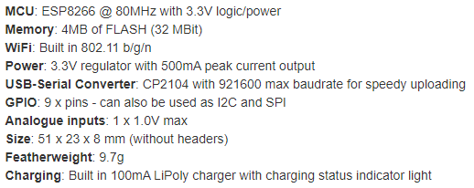
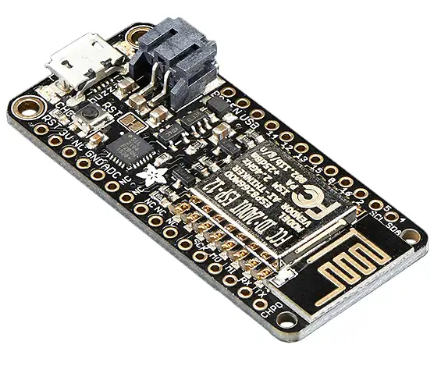
Feather Huzzah ESP8266

Slide 4
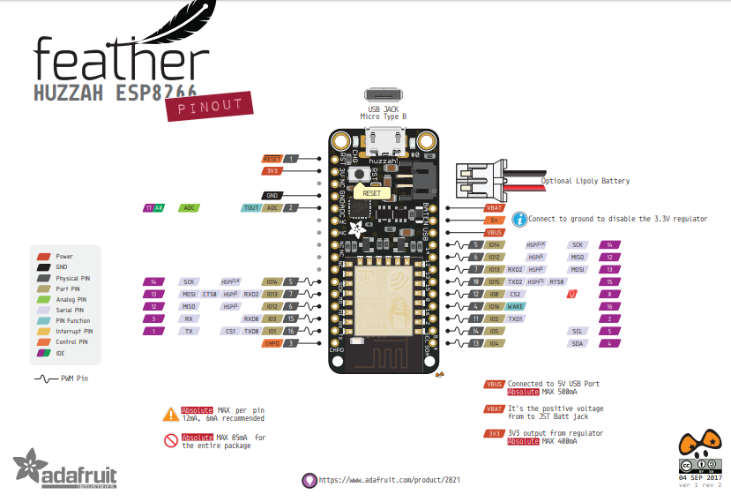
Feather Huzzah ESP8266 Pinout

Slide 5
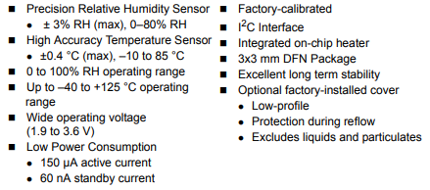
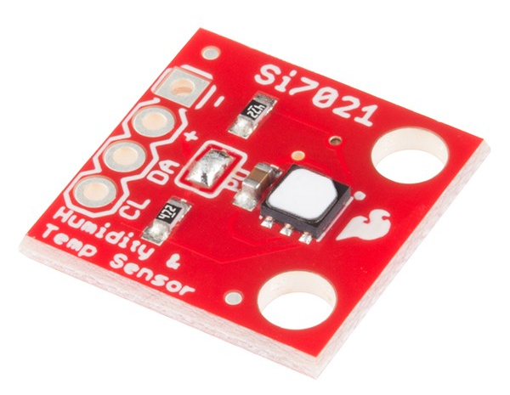
Humidity and Temperature sensor SI7021

Slide 6
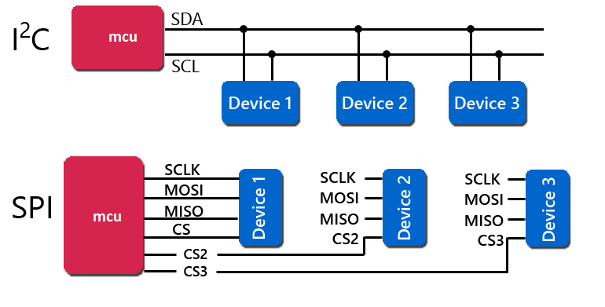
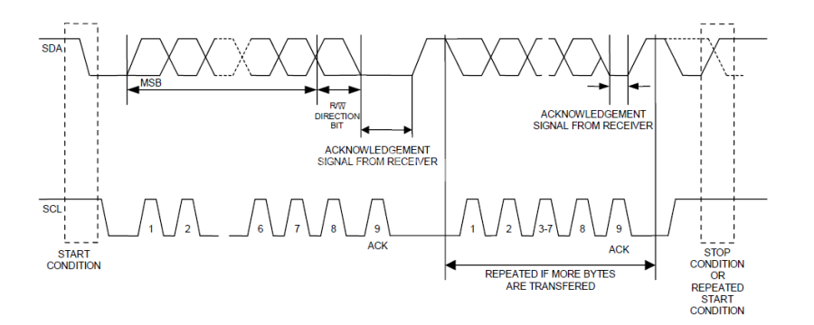
I2C Protocol

Slide 7
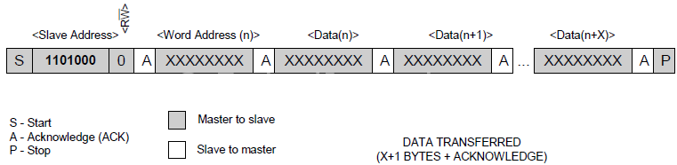
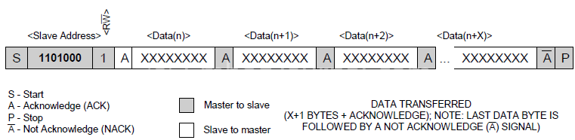
I2C Write and Read

Slide 8
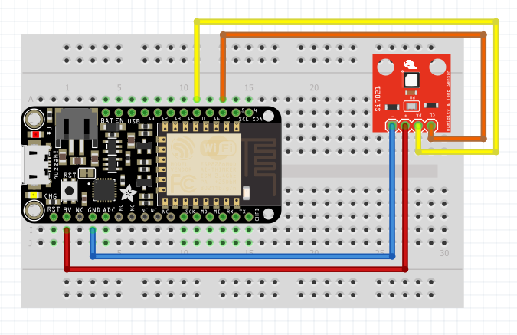
Setup: ESP8266, SI7021

Slide 9
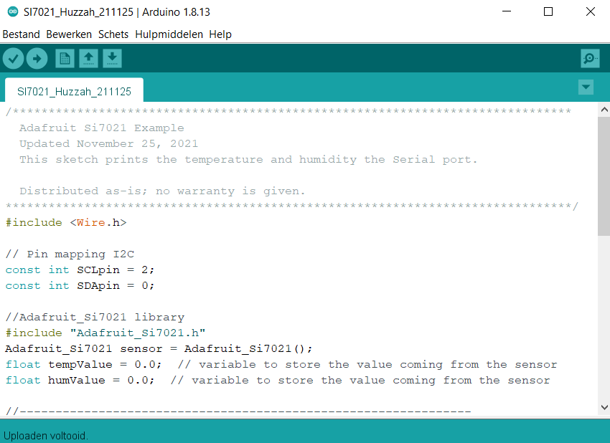
Code: Read sensor

Slide 10
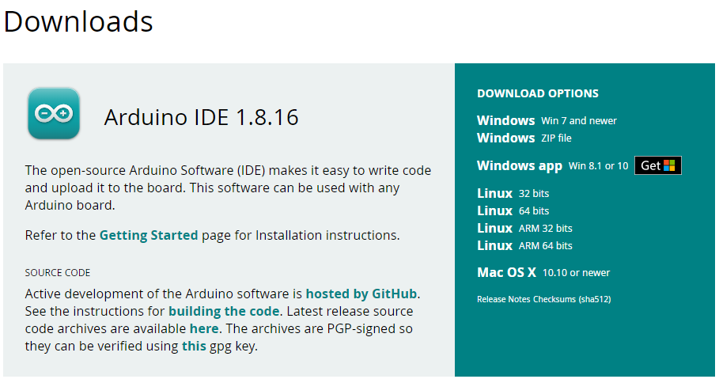
Install Arduino IDE
Go to www.arduino.cc

Slide 11
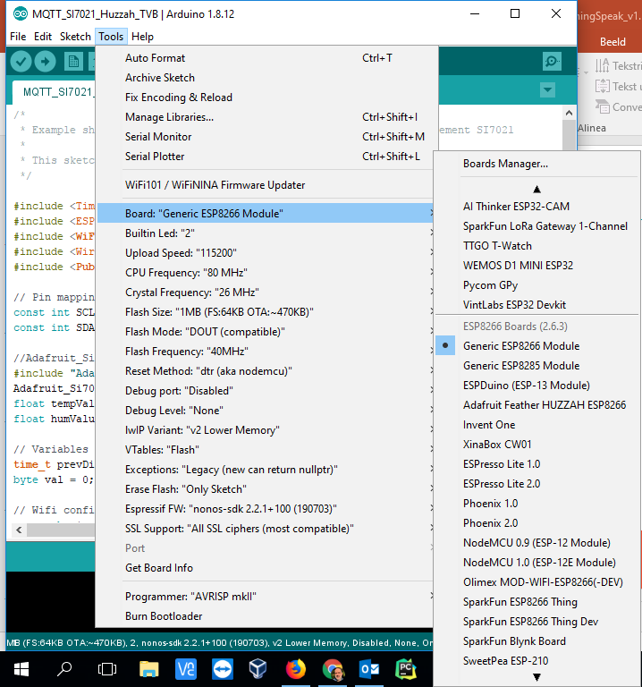
Connect Board/Port
Select ‘Generic ESP8266 Module’
Select COM Port

Slide 12
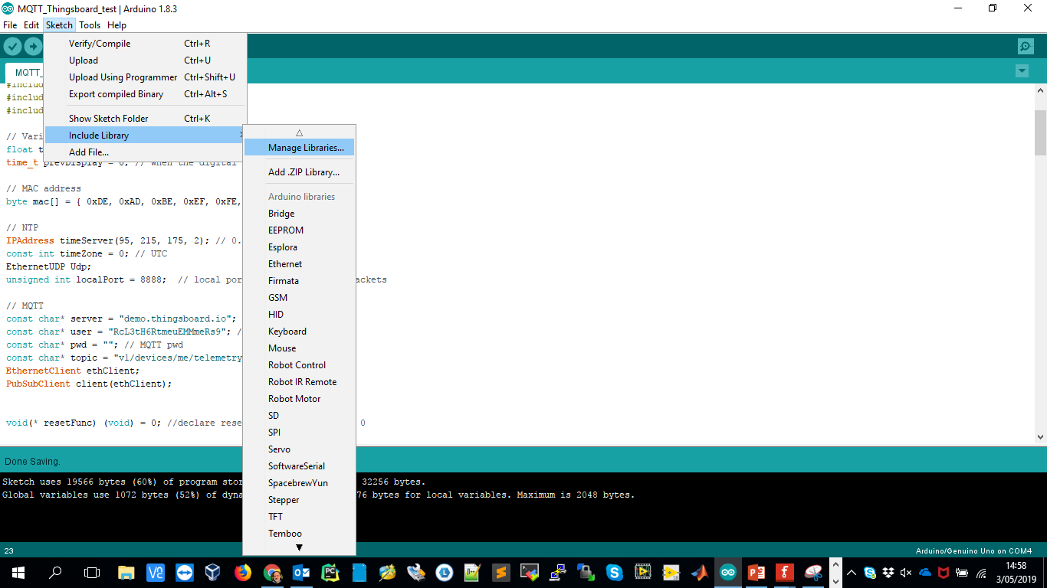
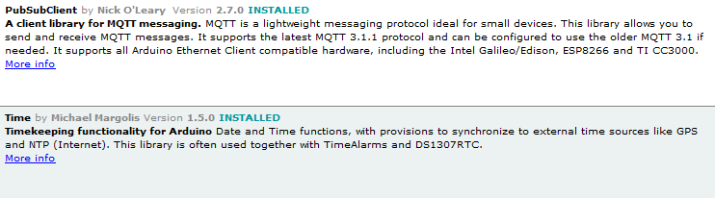
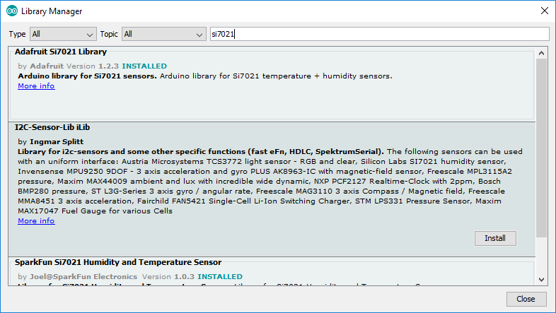
Install libraries

Slide 13
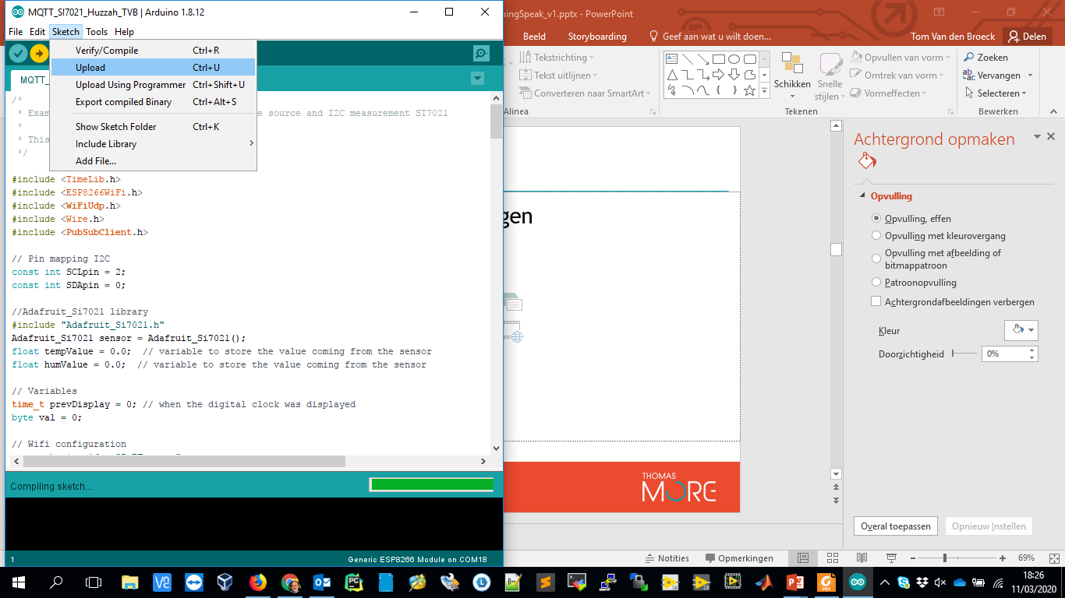
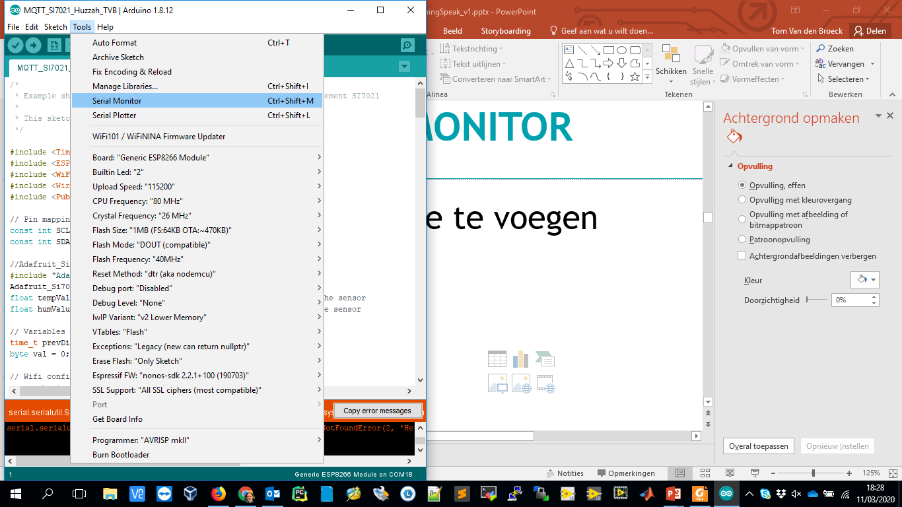
Verify/Compile/Upload Program and open Serial monitor
Select 115200 bps

Slide 14
Part 2
Read sensor over WLAN and MQTT

Slide 15
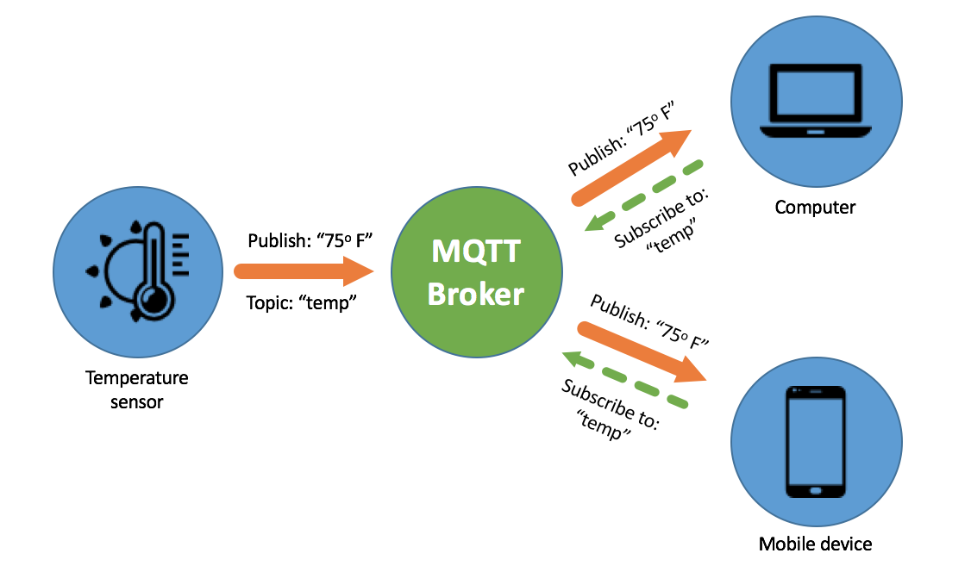
MQTT
‘MQTT (Message Queuing Telemetry Transport) is an ISO standard publish-subscribe-based messaging protocol. It works on top of the TCP/IP protocol. The publish-subscribe messaging pattern requires a message broker.’
http://mqtt.org/

Slide 16
Setup: ESP8266, SI7021

Slide 17
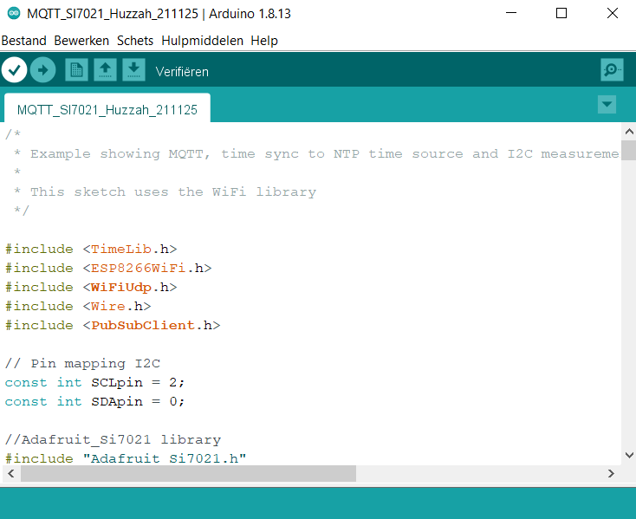
Code: MQTT publisher
Use your personal WiFi and MQTT settings

Slide 18

Thingspeak
ThingSpeak: https://thingspeak.com/
ThingSpeak - MQTT integration:
https://nl.mathworks.com/help/thingspeak/use-arduino-client-to-publish-to-a-channel.html

Slide 19
ThingSpeak Configuration
Find/set in My Profile
Username (MQTT user)
MQTT API Key (MQTT pwd)
Find/set in My Channels
Write API Key
Channel ID

Slide 20
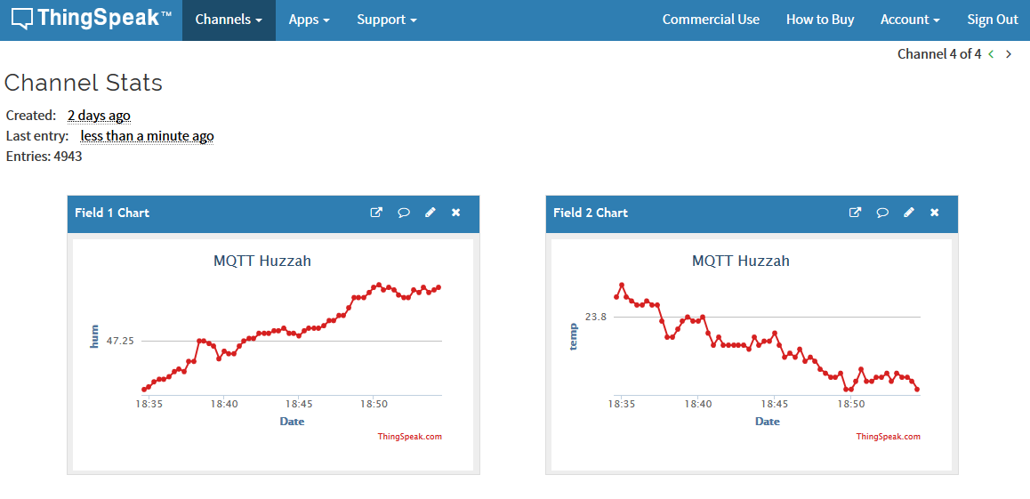
Thingspeak on web

Slide 21
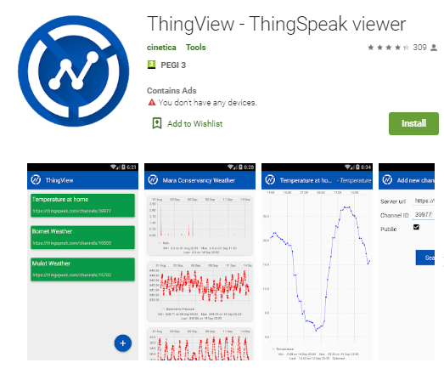
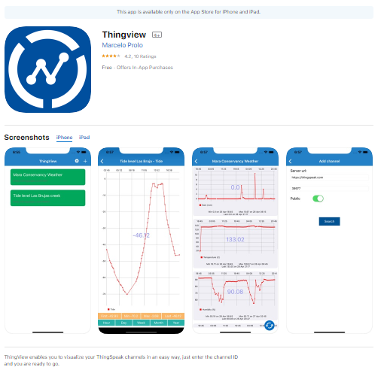
ThingSpeak on mobile device
ThingView on Android or iOS

Slide 22
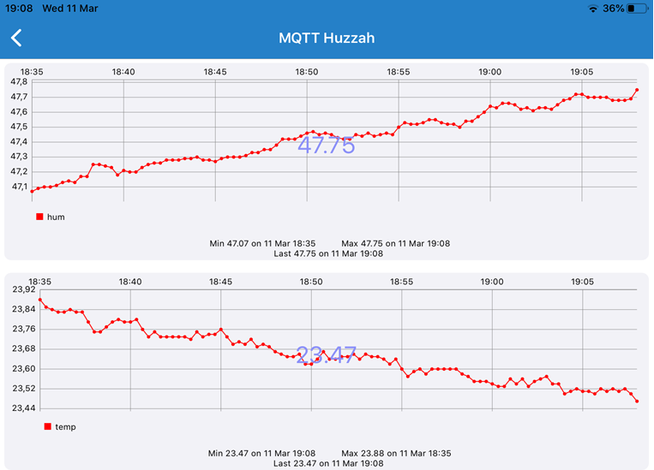
ThingSpeak on mobile device

Slide 23
Part 3
Read sensor over LoRa and The Things Network

Slide 24
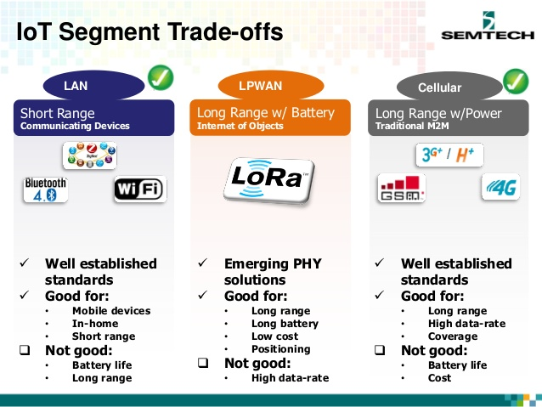
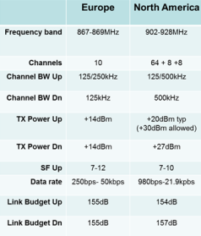
LoRa: Properties

Slide 25
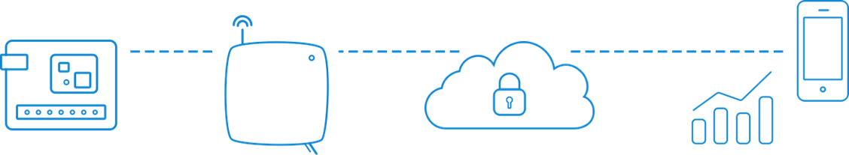
The Things Network
The Things Network is about enabling low power Devices to use long range Gateways to connect to an open-source, decentralized Network to exchange data with Applications.

Slide 26


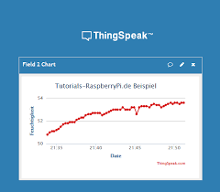

Devices and Gateways
TCP/IP
TCP/IP
TCP/IP
TCP/IP
TTN Indoor Gateway (8ch)
RPi + Dragino Gateway (1ch)
TCP/IP
TCP/IP
Client
(PC)
Server
(cloud)
Arduino MKR WAN 1310
RPi + RFM95W

Slide 27
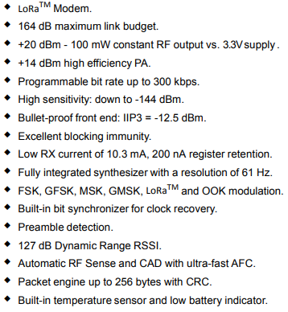
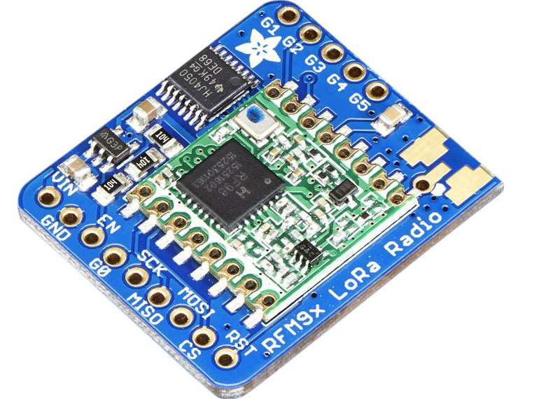
RFM95W LoRa

Slide 28
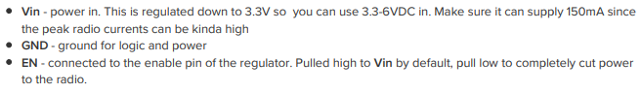
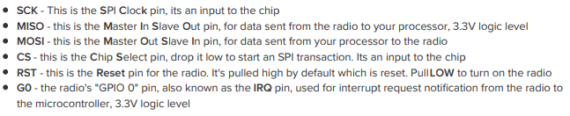
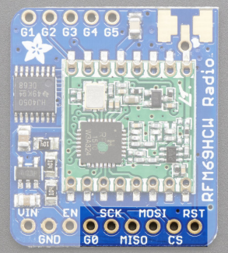
RFM95W LoRa pinout
Power
SPI
GPIO
G0 = DIO0 = TxDone/RxDone
G1 = DIO1 = RxTimeout
Antenna

Slide 29
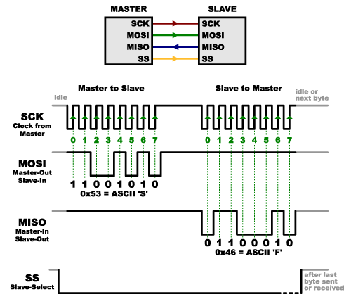
SPI Protocol

Slide 30
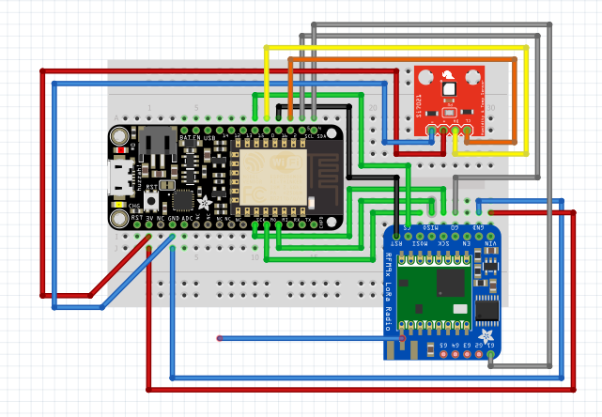
Setup: ESP8266, SI7021 RFM95W

Slide 31
Install Additional Libraries
Go to https://github.com/tftelkamp/arduino-lmic-v1.5 and download zip file.
Unzip.
Copy folder to the libraries folder in your Arduino sketch folder.
Inside this folder go to src/lmic/config.h and comment out line 10 (//#define CFG_sx1272_radio 1) and uncomment line 11 (#define CFG_sx1276_radio 1).

Slide 32
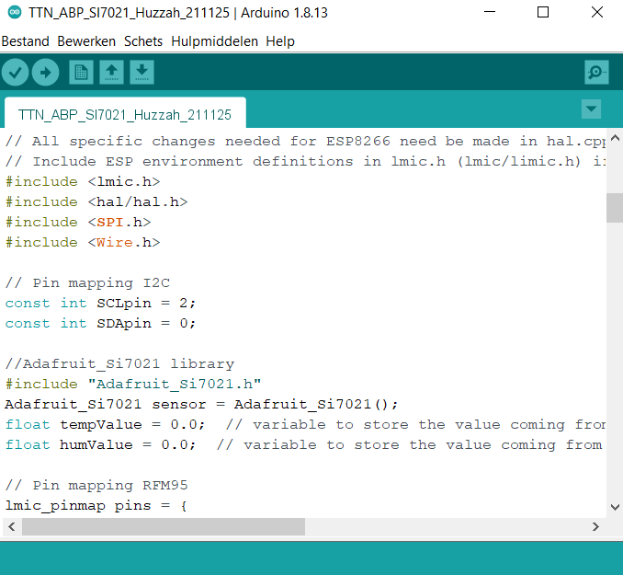
Code: TTN publisher
Use your personal TTN settings

Slide 33
TTN Console
Create an Application and a Device
Activation Method: ABP
Frame Counter Width: 16 bit
No Frame Counter Checks
Find
Application EUI
Device EUI
Network Session Key
App Session Key
Device Address

Slide 34
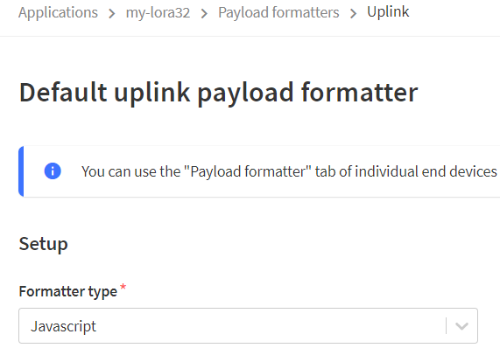
TTN Console: Decoder
// Decoder
function Decoder(bytes, port) {
var decoded = {};
// Decode bytes to int
var humInt = (bytes[0] << 8) | bytes[1];
var tempInt = (bytes[2] << 8) | bytes[3];
// Decode int to float
decoded.hum = humInt / 100;
decoded.temp = tempInt / 100;
return {
field1: decoded.hum,
field2: decoded.temp
}
}

Slide 35
Thingspeak
ThingSpeak: https://thingspeak.com/
ThingSpeak - TTN integration:
https://www.thethingsnetwork.org/docs/applications/thingspeak/

Slide 36
ThingSpeak Configuration
Find/set in My Channels
Write API Key
Channel ID

Slide 37
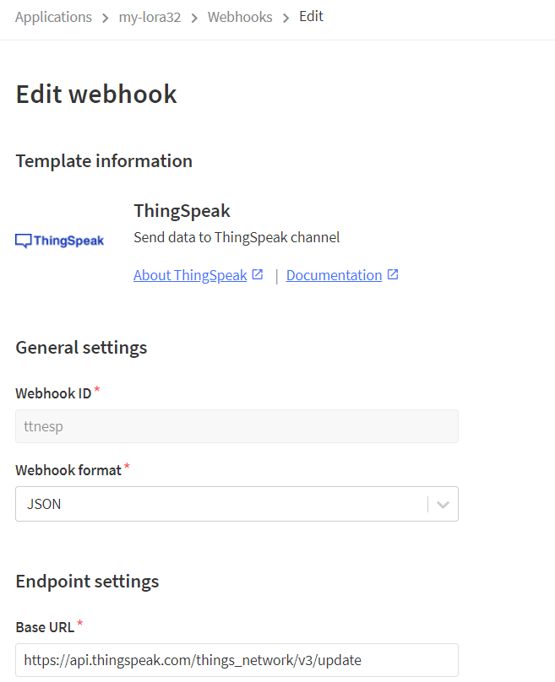
TTN Console: Integrations
Set
Channel write API key
Channel ID

